Slide 1

VULNERABILITY ANALYSIS
Dilsha Keerthi Kumara
12195171
COIT11241
Private Repository :https://github.com/DilshaWe/ePortfolio.git

Slide 2
What is a Vulnerability?
Intrinsic flaw built in
Often well-known
Can be exploited in some way

Slide 3
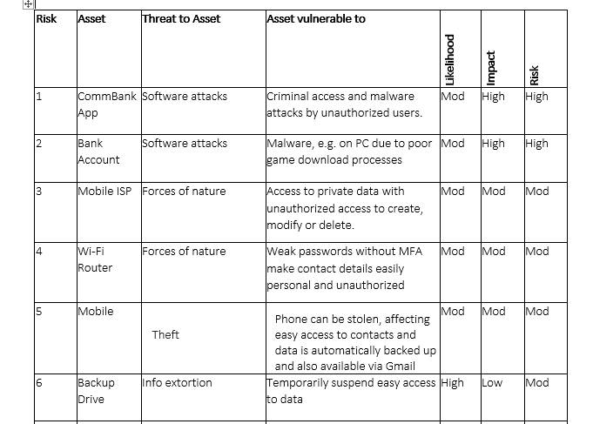
Recap Assignment 2

Slide 4
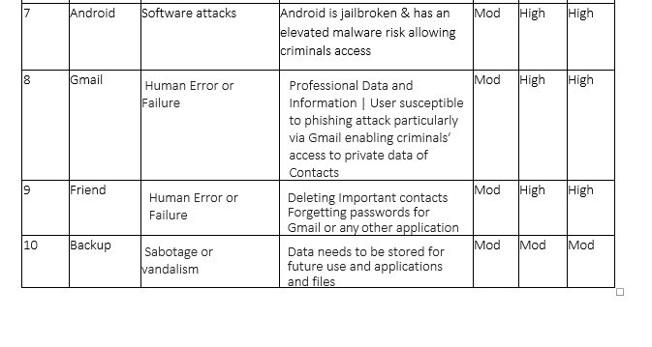
Recap Assignment 2

Slide 5
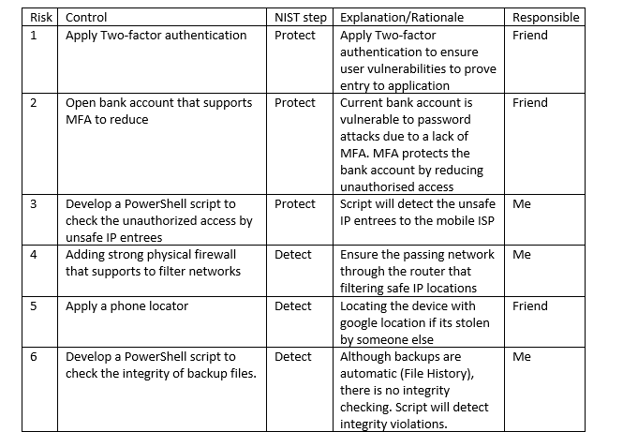
Recap Assignment 2

Slide 6
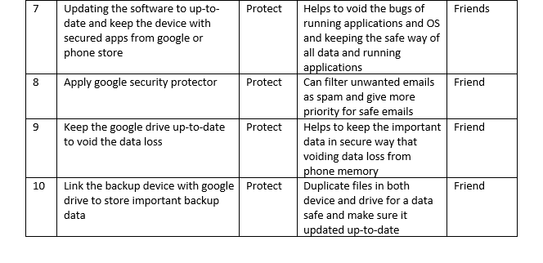
Recap Assignment 2

Slide 7

Nikto for Vulnerability scan of Metasploit VM machine

Slide 8
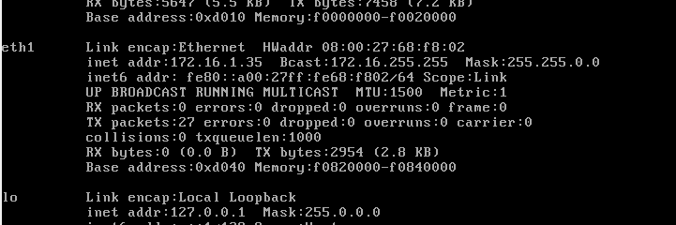
Check the IP address of Metasploit VM

Slide 9
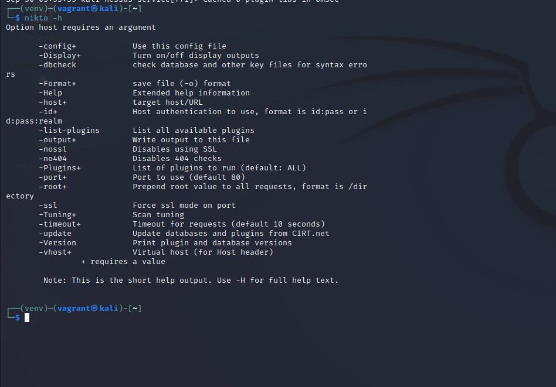
NIKTO in Kali linux and Metasploitable 2

Slide 10
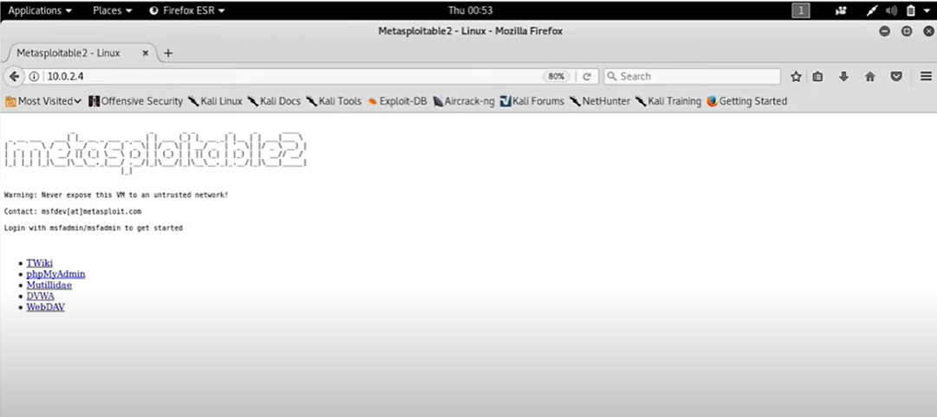
NIKTO in Kali linux and Metasploitable 2

Slide 11
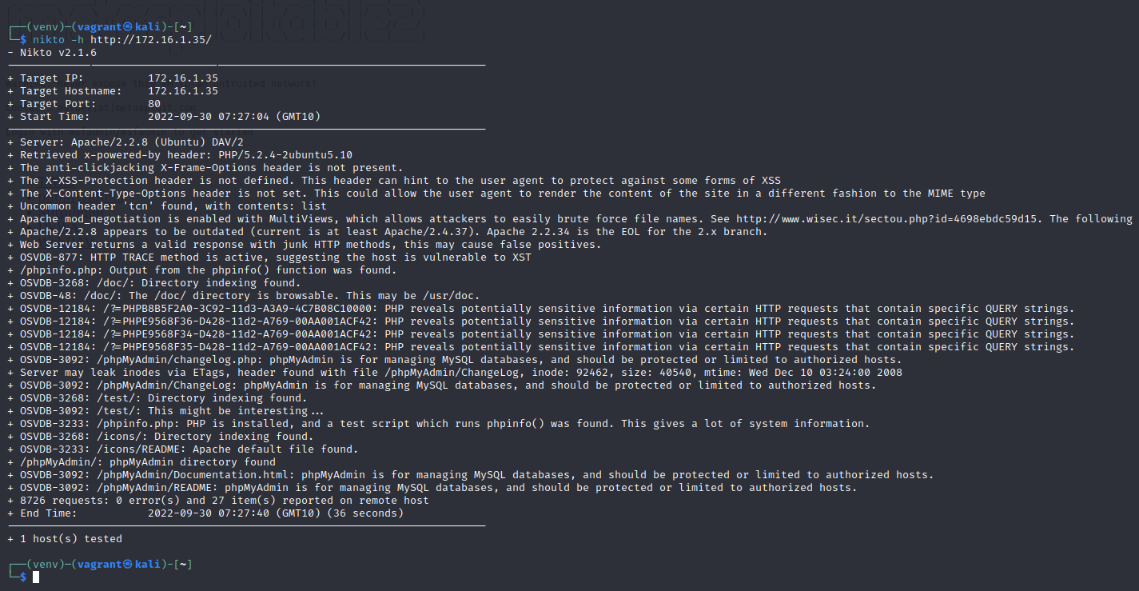

Slide 12
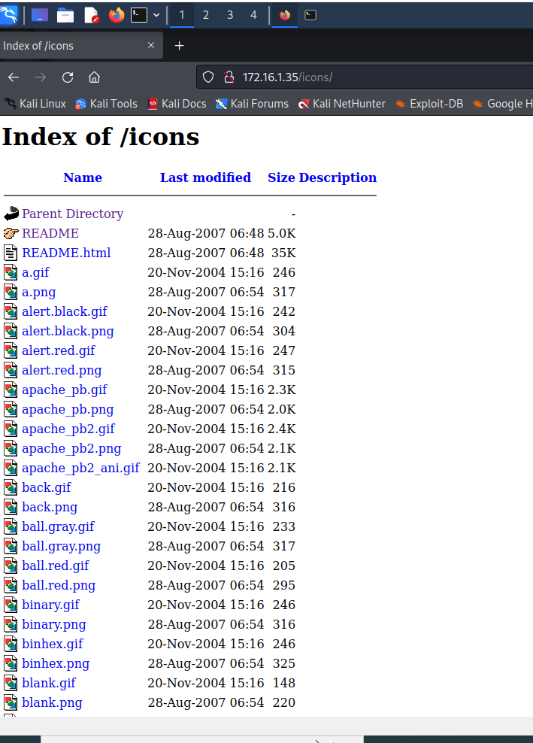
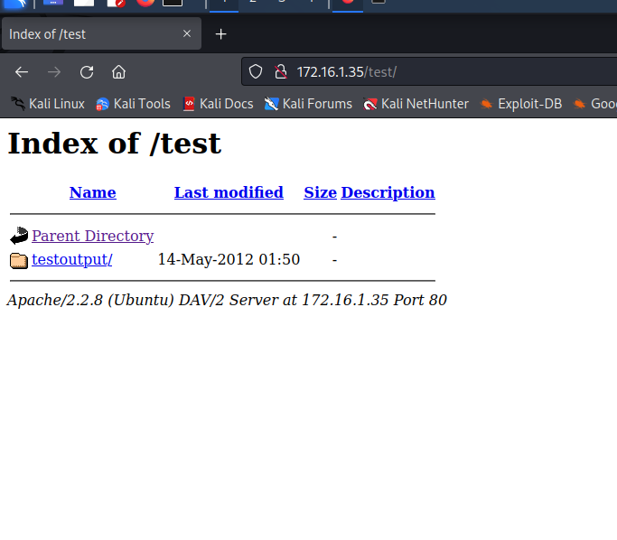

Slide 13
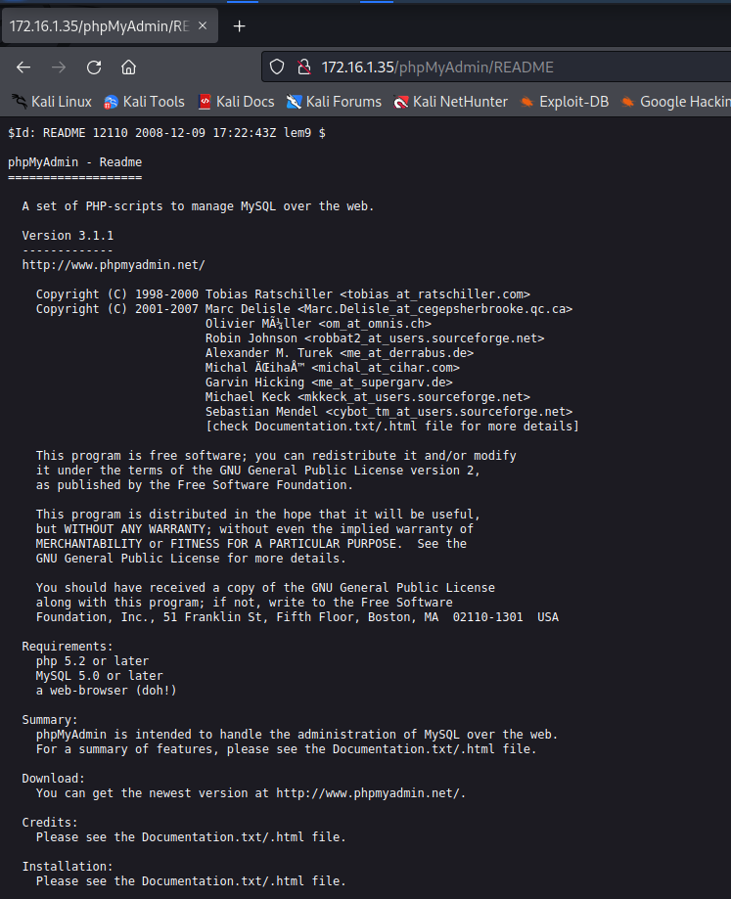

Slide 14
Scan victim machine with Nessus
Create a scan.
1
Select the Basic Network Scan for the home use edition.
2
Configure the Scan
3
Launch the Scan
4

Slide 15
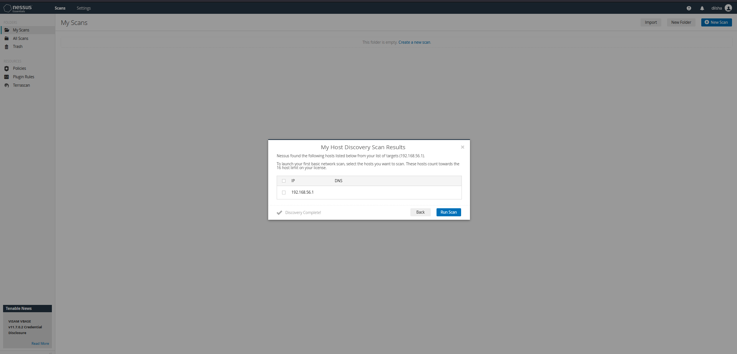
Vulnerability Scan of Windows 10 OS using Nessus

Slide 16
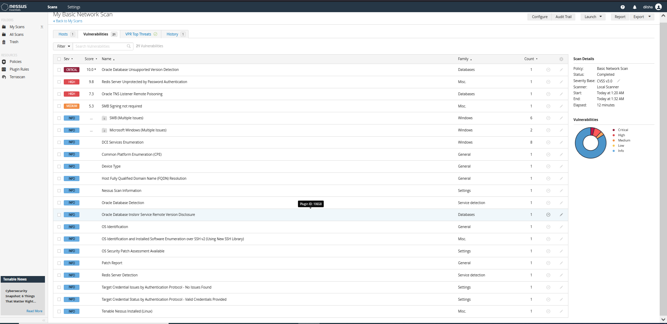

Slide 17
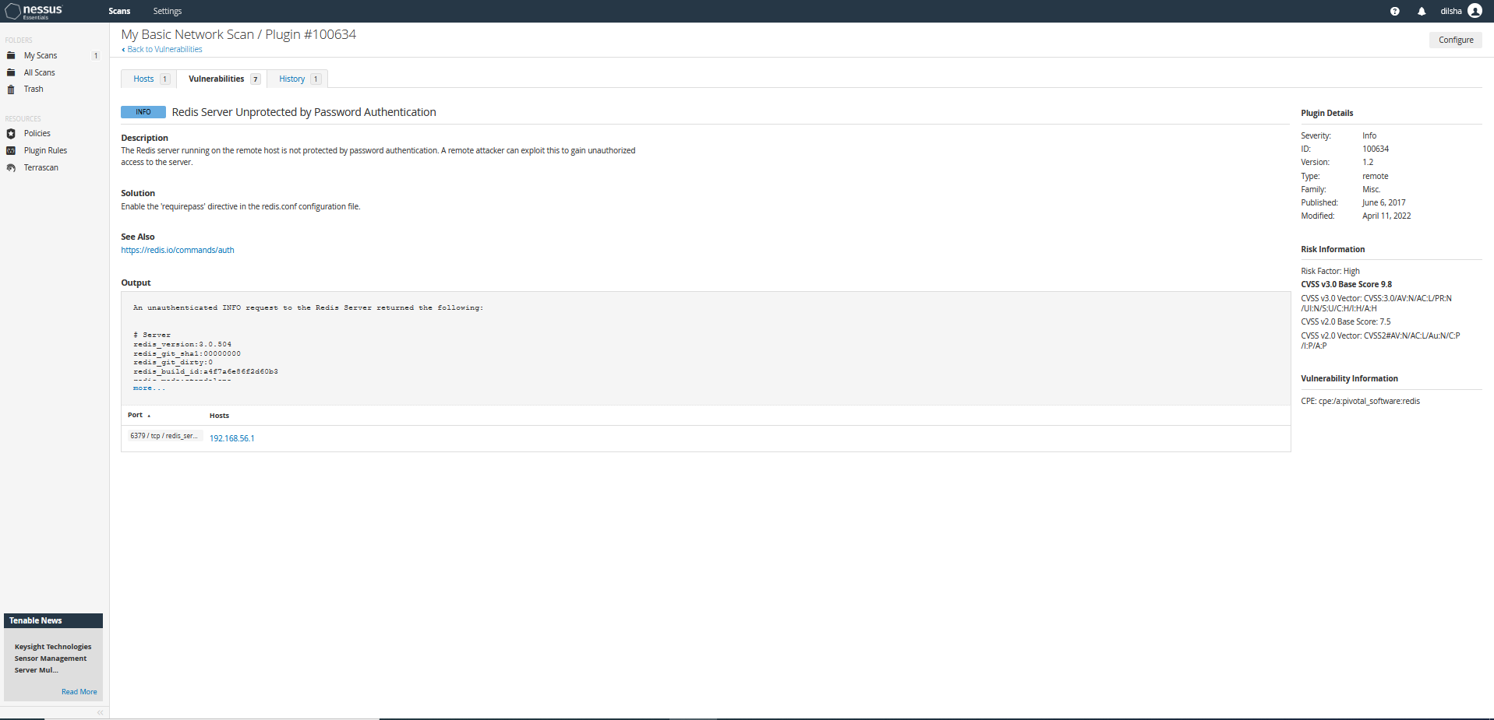

Slide 18
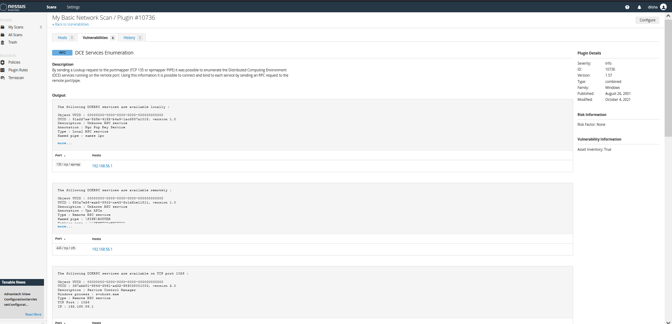

Slide 19
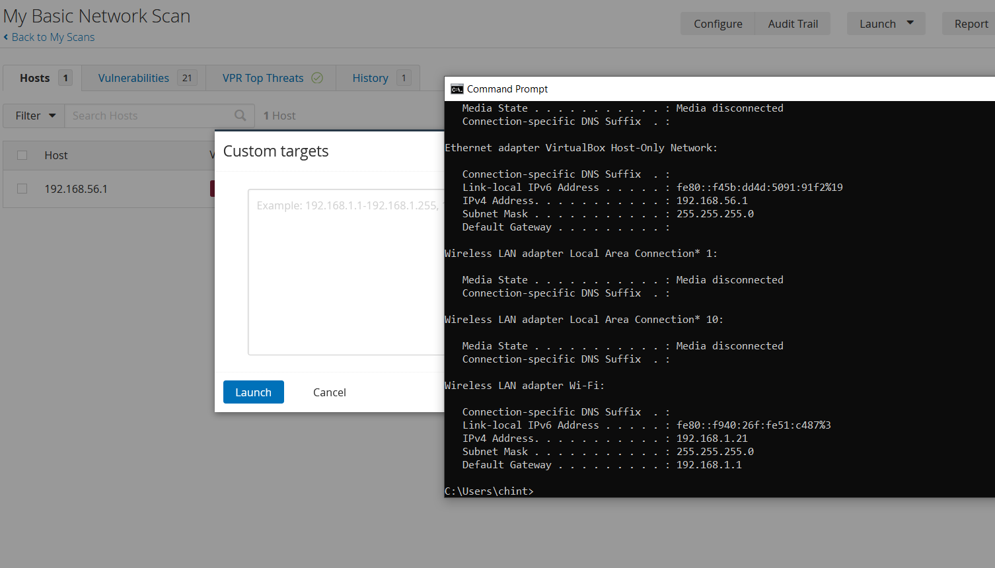
Check vulnerabilities of my router by using Nessus Tool

Slide 20
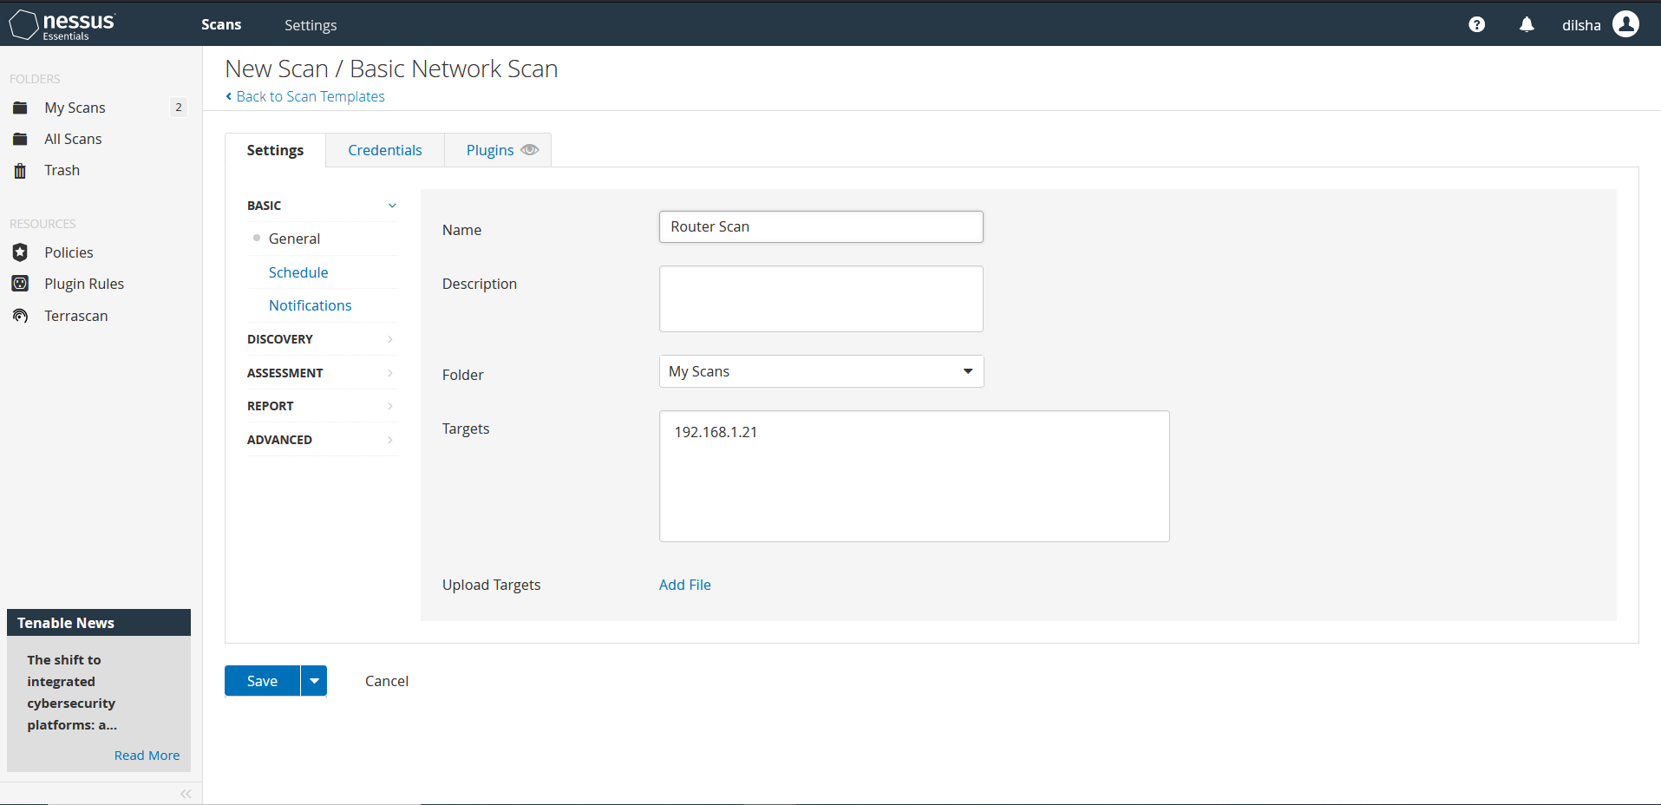

Slide 21
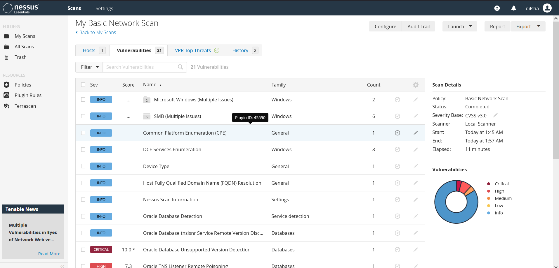

Slide 22
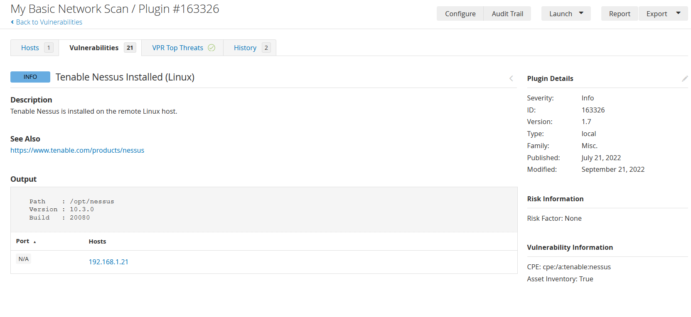

Slide 23
Vulnerabilities revealed by Nessus scan for Metasploitable2
rsh Unauthenticated Access
Proposed fix: Remove the .rhosts files or set a password on the impacted accounts.
Samba Heap-Based Remote Buffer Overflow
Proposed fix: Upgrade to Samba version 3.0.25 or later.
Apache Tomcat Manager Common Administrative Credentials
Proposed fix: Edit the associated “tomcat-users.xml” file and change or remove the affected set of credentials.
vsftpd Smiley Face Backdoor
Proposed fix: Use a legitimate copy of the vsftpd software.

Slide 24
1
Distributed Denial of Service Attack
4
Vulnerabilties
In Routers
Credential Hacking
2
Syn Flood
5
Session Hijacking
3
Brute Force

Slide 25

Recommendations to Manage Vulnerabilities
Disable Remote Access
Use a Network Inspector
Routinely Update the Router Firmware
Set Up a Guest Account
Reset the Router and Passwords
Turn on WiFi network encryption
Turn on your router firewall

Slide 26
1
CryptoAPI spoofing vulnerability
4
Vulnerabilties
In Windows
Computers
Microsoft Font Driver Vulnerability
2
Windows RD Gateway Vulnerabilities
5
Win32k Elevation of Privilege Vulnerability
3
Windows Remote Desktop Client Vulnerability

Slide 27
Recommendations to Manage Vulnerabilities
Update OS systems using the most recent Microsoft patch level.
Install the most recent virus definitions in your anti-virus programs.
Always keep an eye out for any potentially dangerous activity using your EDR and anti-malware tools and solutions.
Turn on the Firewall.

Slide 28
1
Binary Protection
4
Vulnerabilties
In Android Mobile
Devices
Certifi-Gate Vulnerability
2
QuadRoot vulnerability
5
Vulnerabilities installed by OEMs
3
HummingBad

Slide 29
Recommendations to Manage Vulnerabilities
Binary Protection – Keep a close eye on the applications you install on your Android device, especially if it has been rooted. Some root apps copy your device's data covertly and make it available to a third party.
QuadRoot vulnerability – Update the mobile OS
HummingBad - Run a factory reset on your device, then use your computer to reset your Google password so you may use fresh login information to activate your Android.
Certifi-Gate Vulnerability - Ask your manufacturer for an OS upgrade and remove all suspicious applications from your device.
Vulnerabilities installed by OEMs - Before purchasing a product from an unknown vendor, always check reviews on reputable tech review sites.

Slide 30

Implementation of Top 10 Controls

Slide 31
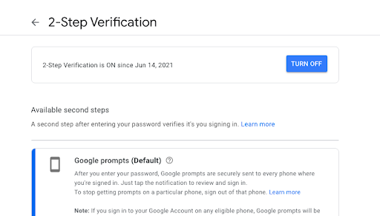
Apply two-factor authentication.

Slide 32
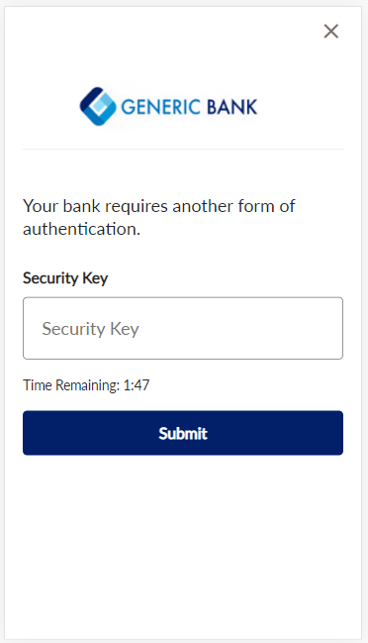
Open bank account that supports MFA.

Slide 33
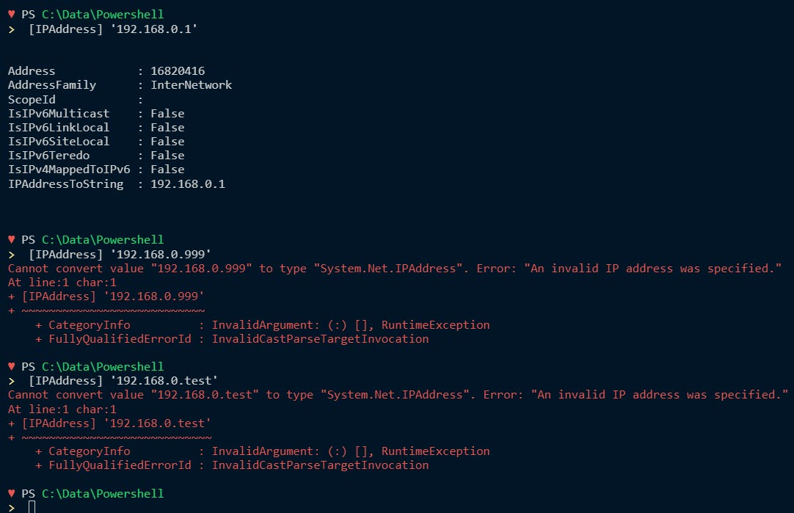
Develop a PowerShell script to check the unauthorized access by unsafe IP entrees.

Slide 34
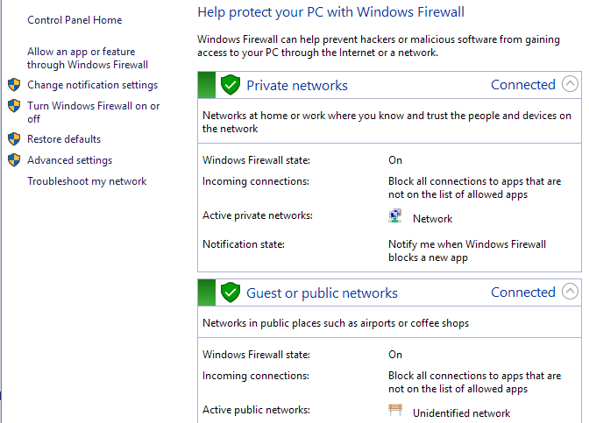
Adding strong physical firewall that supports to filter networks

Slide 35
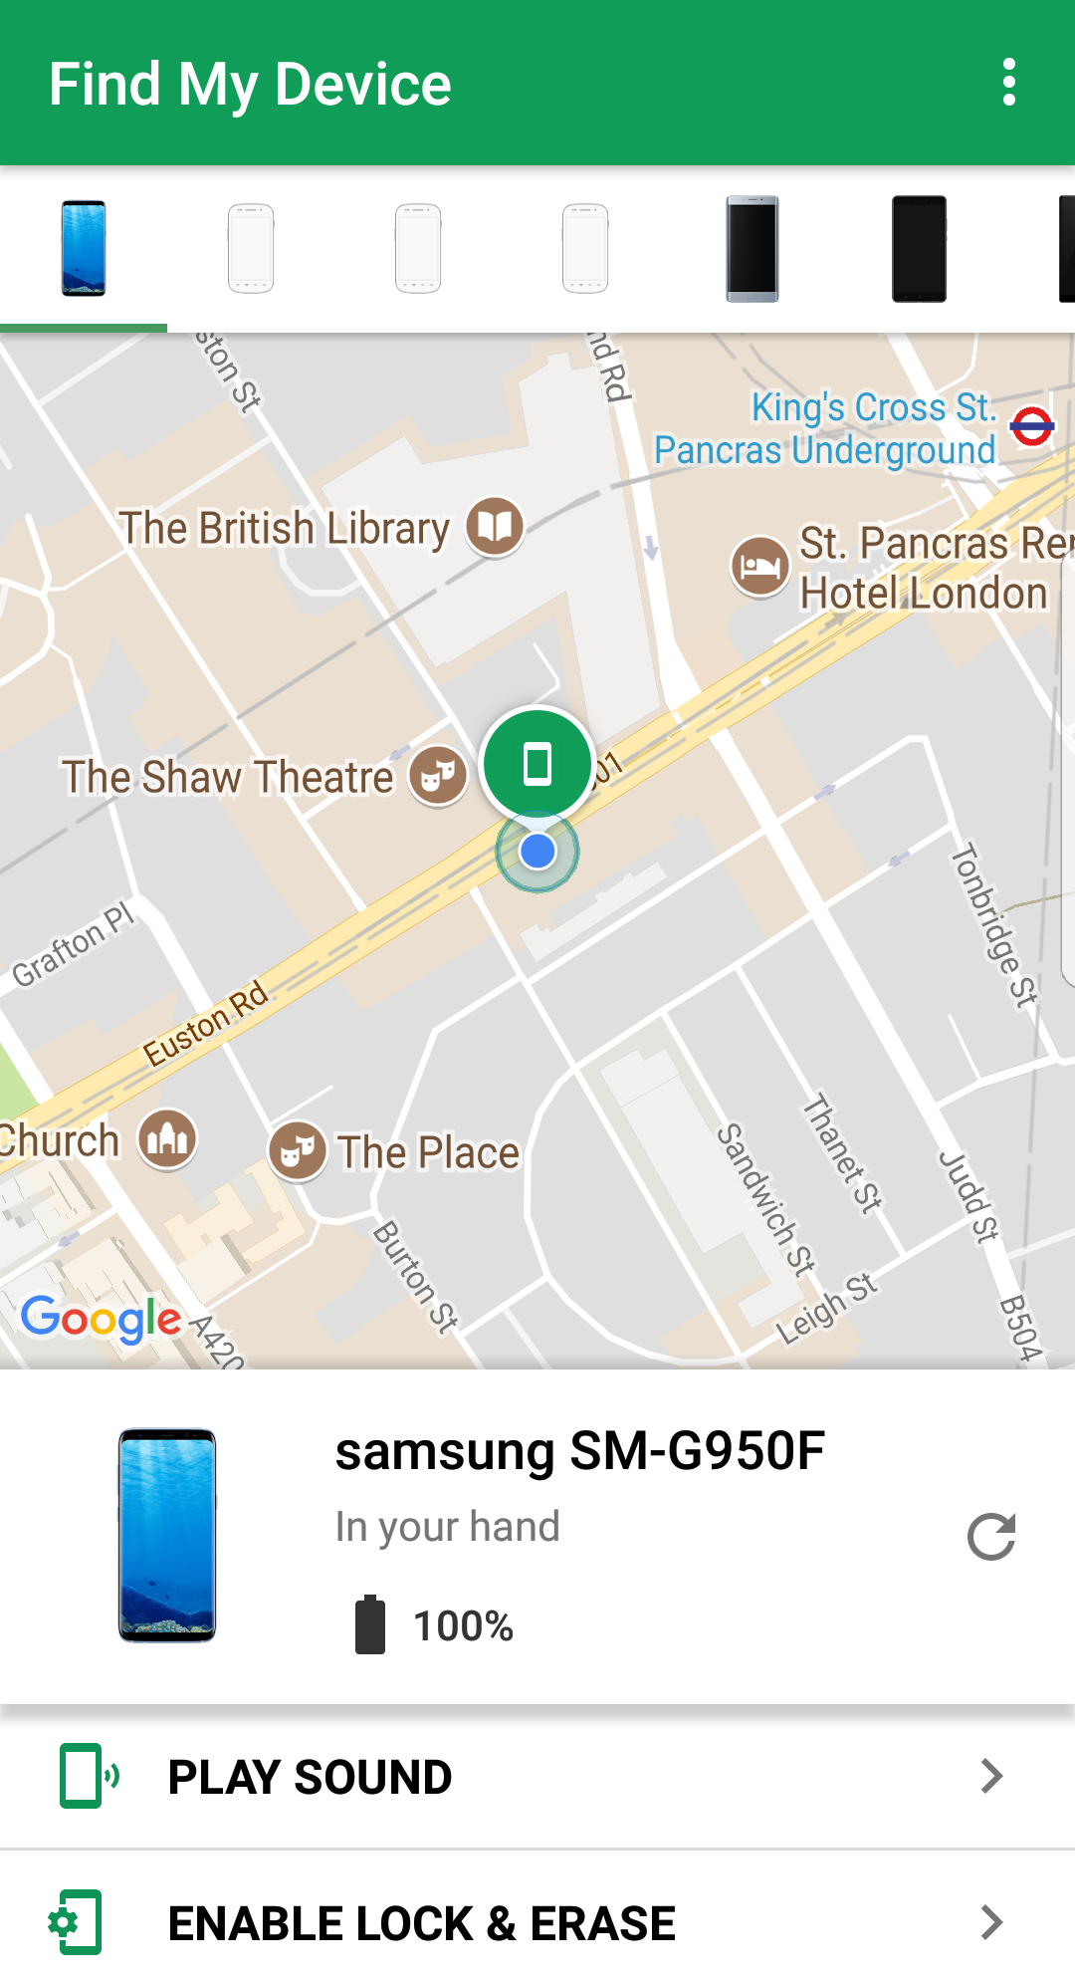
Apply a phone locator

Slide 36
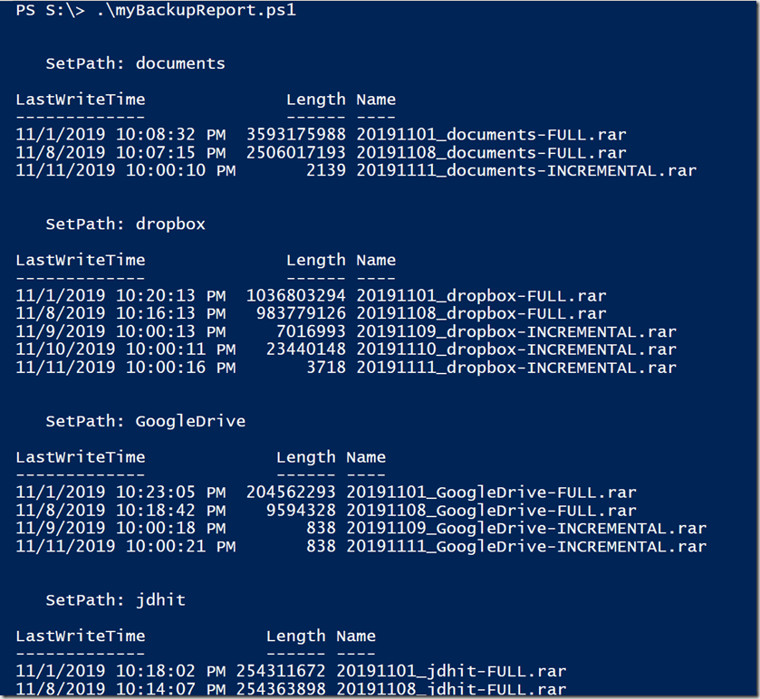
Develop a PowerShell script to check the integrity of backup files.

Slide 37
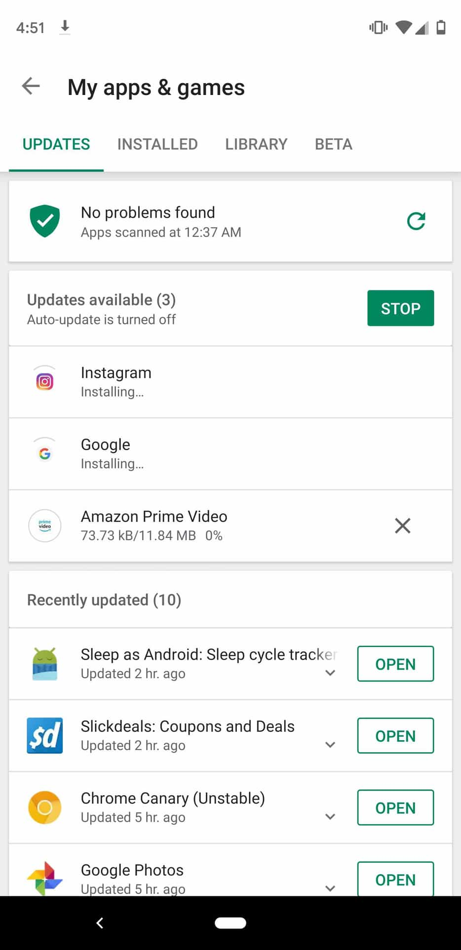
Keeping the software to up-to-date and keep the device with secured apps from google or phone store

Slide 38
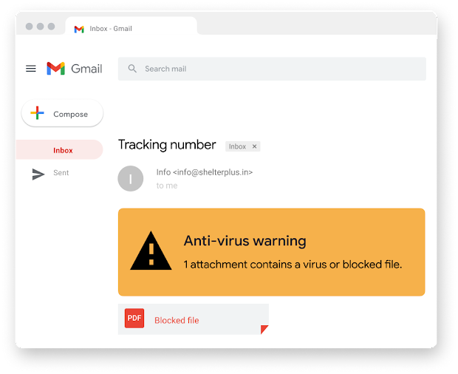
Apply google security protector

Slide 39
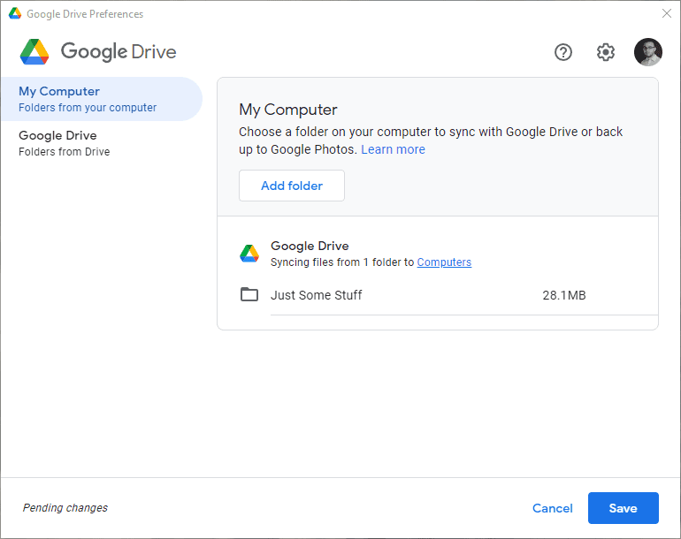
Keep the google drive up-to-date to avoid the data loss

Slide 40
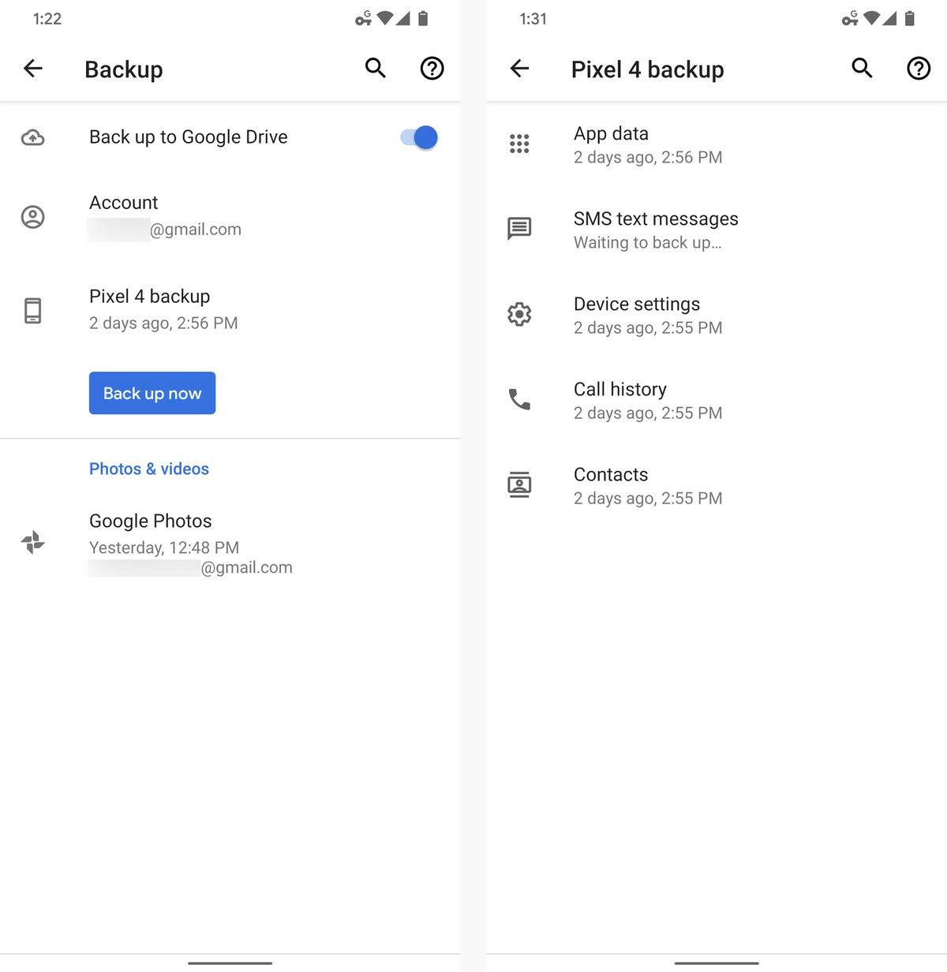
Link the backup device with google drive to store important backup data

Slide 41
References
Horowitz, D. (2021, August 25). 10 best ways to protect your home network security: HP® Tech takes. 10 Best Ways To Protect Your Home Network Security | HP® Tech Takes. Retrieved September 28, 2022, from https://www.hp.com/us-en/shop/tech-takes/best-ways-to-protect-home-network-security
How to fix the top 10 Windows 10 vulnerabilities [infographic]: Upguard. RSS. (n.d.). Retrieved September 28, 2022, from https://www.upguard.com/blog/top-10-windows-10-security-vulnerabilities-and-how-to-fix-them
Tech2020. (2021, January 18). What is nessus and how does it work? - ITPERFECTION - network security. ITperfection. Retrieved September 28, 2022, from https://www.itperfection.com/network-security/network-monitoring/what-is-nessus-and-how-does-it-work-network-munitoring-vulnerabilit-scaning-security-data-windows-unix-linux/
Casey, K. (2021, October 22). Top 7 vulnerabilities in Android Applications 2022. CODERSERA. Retrieved September 28, 2022, from https://codersera.com/blog/top-7-vulnerabilities-in-android-applications-2019/
Analysis on security vulnerabilities of routers. Huawei. (n.d.). Retrieved September 28, 2022, from https://support.huawei.com/enterprise/en/doc/EDOC1100125841/f4f8c921/analysis-on-security-vulnerabilities-of-routers

Slide 42
Thank You!

